Slide 1

A MAJOR PROJECT ON
FILE SECURITY USING CRYPTOGRAPHY IN PYTHON
PRESENTED BY:
E.MADHURI - 17TQ1A0527
M.AKRAM BAIG - 17TQ1A0556
O.THARUN - 17TQ1A0565
B.RAJASHEKAR - 16TQ1A0518
T.ROJA - 16TQ5A0503
UNDER THE GUIDANCE OF
Mrs.D.SIRISHA

Slide 2
ABSTRACT
Data encryption translates data into another form, or code, so that only people with access to a secret key(formally called a decryption key) or password can read it.
Encrypted data is commonly referred to as ciphertext, while unencrypted data is called plaintext.
Currently, encryption is one of the most popular and effective data security methods used by organizations.
Data can be any file like Image,Audio,Video,Text file or any other document.
The purpose of data encryption is to protect digital data confidentiality as it is stored on computer systems and transmitted using the internet or other computer networks.

Slide 3
INTRODUCTION
Information transmission through internet may include sensitive personal data which may be intercepted By some Third party.
In this project we mainly focused on Securing files which contain sensitive data.
Cryptography is the common method to secure communications and Data files.
Private Keys and Public Keys are used for encryption and decryption of the Data.
These keys are used to encrypt/decrypt sensitive information stored in the Files.

Slide 4
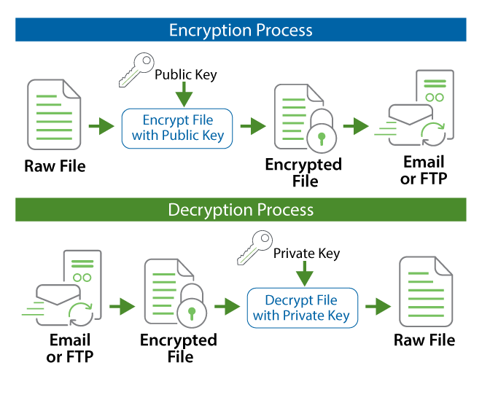

Slide 5
EXISTING SYSTEM:
Security is the main Issue when Securing any file, Some Encryption Methods doesn’t provide much security.
The Keys used for Encryption Process are very small in size
PROPOSED SYSTEM:
This System provides more security as we use large key size.(1024 bits Minimum).
Any type of file(Audio,Video,Text) can be encrypted using a single program.

Slide 6
ADVANTAGES
‣ Key size is more Compared to others.
‣ We can Generate Key of Multiple sizes.
‣ Can Encrypt any kind of file(Audio,Video,Text)
DISADVANTAGES
‣ When Encrypting Large Files, the Encryption and Decryption Process is Slow.

Slide 7
SOFTWARE REQUIREMENTS:
‣ Visual Studio Code (IDE)
‣ Python 2.7.x Version
‣ Operating System - Windows 10 (or) MAC OS (or) Linux OS

Slide 8
HARDWARE REQUIREMENTS:
‣ Processor - Intel i3 Dual Core or Above
(or)
Ryzen 3 1200 or Above
‣ Hard Disk - 250GB
‣ Memory - 4GB RAM

Slide 9
CONCLUSION
‣ Files transferred through unsecured channels can be misused by insiders or hackers for malicious activities. So, It is vital to Encrypt the confidential data before storing or sending them.
‣ So, the main concern of our project is to Secure all types of Files Using a single program with the help of large size cipher
keys.

Slide 10


